Slide 1

UNIVERSITY OF MINES AND TECHNOLOGY (UMaT)
FACULTY OF GEOSCIENCES & ENVIRONMENTAL STUDIES
DEPARTMENT OF ENVIRONMENTAL AND SAFETY ENGINEERING
TOPIC:
Human Factor Contributions To Heavy Mining Equipment Damages and Its Impact on Production: A Case Study of a Ghanaian Mining Contractor
BY: SAGOE ISAAC
SUPERVISOR: DR. ERIC STEMN
13TH June, 2025

Slide 2
OUTLINE
Introduction
Objectives of the Study
Methods Used
Facilities and Resources Used
Results and Discussion
Conclusions
Recommendation
References

Slide 3
INTRODUCTION
The mining industry has witnessed an increasing reliance on heavy mobile equipment to meet the rising demands of production, particularly within the Ghanaian gold mining sector (Stemn et al., 2022).
The industry regardless of its contribution to socioeconomic development is undoubtedly considered as a safety–critical industry due to the hazardous nature of its activities, the working environment and the equipment used (Gyekye SA., 2003).

Slide 4
INTRODUCTION CONT’D
There exists a prevalent belief that accidents and equipment failures are primarily caused by the unpredictable behavior of individuals referred to as the “Bad Apple Theory” (Dekker, 2006) .
Since Industrialization, Human Error has significantly impacted mining operations by causing equipment failures, reduced productivity and increase in costs (Reason, 1990)
There’s the need for application of system approach in incident investigation, shifting from active failures (human errors) to latent systemic factors/failure (Dekker, 2002).

Slide 5
INTRODUTION CONT’D
Human factors encompass the interactions between operators, the equipment, and the work environment, and are increasingly recognized as a key element influencing industrial accidents (Reason, 1990).
Human-Induced errors as major contributor to operational and maintenance failures in machinery, are often overlooked despite their significant impact (Dhillon, 2014)
However, understanding and mitigating the influence of human factors is essential for improving safety, reducing errors, enhancing productivity, and increasing the overall efficiency of mining operations (Simpson and Horberry, 2018).

Slide 6
OBJECTIVES OF THE STUDY
The objectives for this study are to ;
To Identify Human Factor contributions to equipment damages.
To Investigate the Relationship between Equipment Damages and Production.

Slide 7
METHODS USED
The study involved a;
Thematic and quantitative analysis on secondary data from the Ghanaian mining contractor using Microsoft excel
Correlation analysis using R-studio programming software
Wilcoxon rank - sum test was used to test the hypothesis formed using R-studio programming software.

Slide 8
FACILITIES AND RESOURCES USED
Incident Data on Equipment Damages, Equipment Downtimes and Production Figures from the Ghanaian Mining Contractor
Library and internet facilities from the University of Mines and Technology (UMaT)
A personal laptop with Microsoft Office Suite (Word, Excel and Power Point)
R-Studio programming Software

Slide 9
RESULTS AND DISCUSSIONS
OVERALL SUMMARY
year | total cost of damaged component | total mean time to repair | total equipment downtime | total production revenue lost | total incident | equipment downtime per incident | revenue lost per hour of downtime | average revenue lost per incident | mean time to repair per incident
2019 | 178000.00 | 60.00 | 816.00 | 1570552.04 | 2 | 408.00 | 1924.70 | 785276.02 | 30.00
2020 | 172100.00 | 221.20 | 1222.50 | 258541.94 | 12 | 101.88 | 211.49 | 21545.16 | 18.43
2021 | 133000.00 | 104.00 | 647.40 | 324090.66 | 14 | 46.24 | 500.60 | 23149.33 | 7.43
2022 | 96860.00 | 80.00 | 314.40 | 764644.83 | 15 | 20.96 | 2432.08 | 50976.32 | 5.33
2023 | 32750.71 | 25.00 | 96.60 | 130815.14 | 4 | 24.15 | 1354.19 | 32703.79 | 6.25
2024 | 2460.00 | 9.00 | 30.00 | 3281.04 | 2 | 15.00 | 109.37 | 1640.52 | 4.50
2019 -2024 | 615170.71 | 499.20 | 3126.90 | 3051925.65 | 49 | 63.81 | 976.02 | 47825.12 | 10.19

Slide 10
RESULTS AND DISCUSSIONS CONT’D
CATEGORIZATION BASED ON CAUSE
Category | Number of Incidents | Percentage | TDT (HOUR) | TMTR (HOUR) | TRL ($)
Human Error (Active failures) | 23 | 46.94 | 2,050.20 | 230.20 | 2,070,318.21
Latent Failures | 26 | 53.06 | 1,076.70 | 269.00 | 981,607.44
Total | 49 | 100 | 3,126.90 | 499.20 | 3,051,925.65

Slide 11
RESULTS AND DISCUSSIONS CONT’D

Slide 12
RESULTS AND DISCUSSIONS CONT’D

Slide 13
RESULTS AND DISCUSSIONS CONT’D

Slide 14
RESULTS AND DISCUSSIONS CONT’D

Slide 15
RESULTS AND DISCUSSIONS CONT’D
Insignificant: RL < $1K
Minor: $1K < RL < $10K Moderate: $10K < RL < $100K
Major: $100K < RL < $1M
Catastrophic: RL > $1M

Slide 16
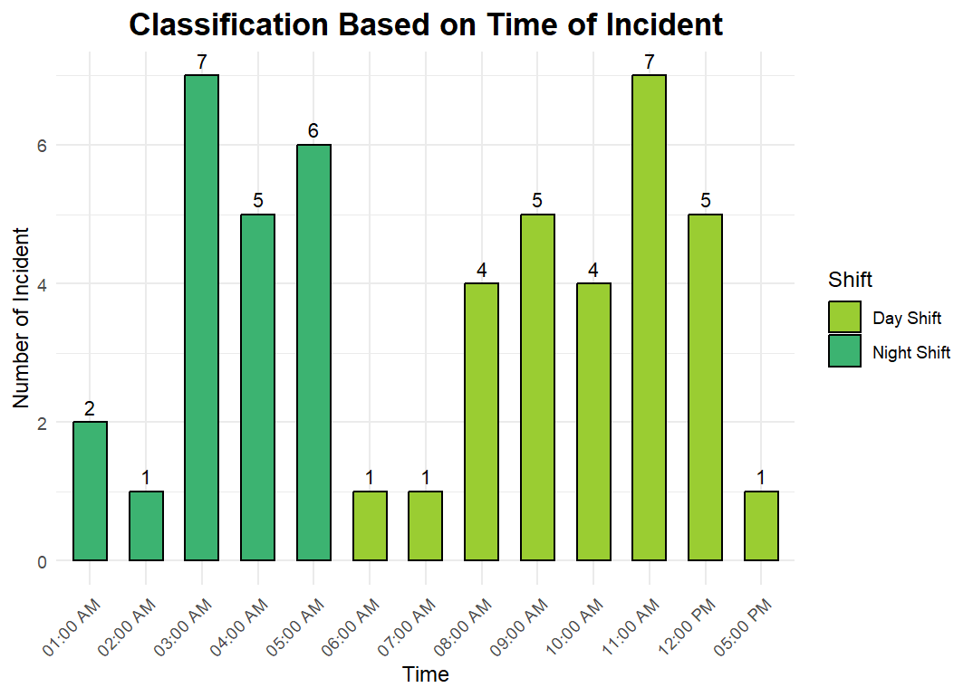
RESULTS AND DISCUSSIONS CONT’D

Slide 17
RESULTS AND DISCUSSIONS CONT’D
Youth:18 to 29
Young adult: 30 to 39
Adult: 40 to 49
Old adult : >50
Unkown: not in data

Slide 18
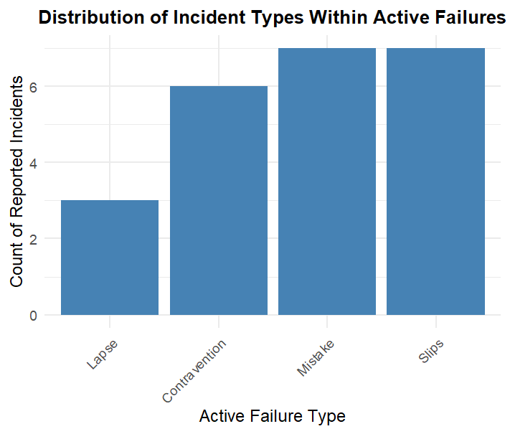
RESULTS AND DISCUSSIONS CONT’D

Slide 19
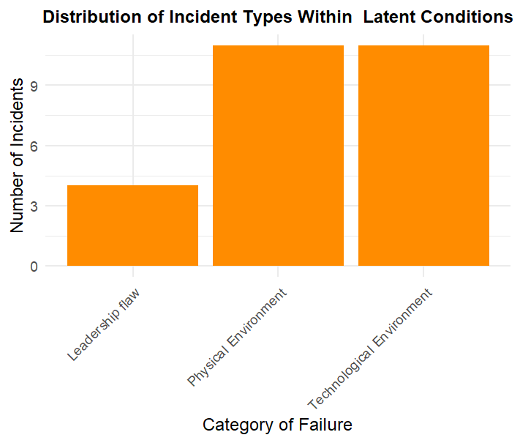
RESULTS AND DISCUSSIONS CONT’D

Slide 20
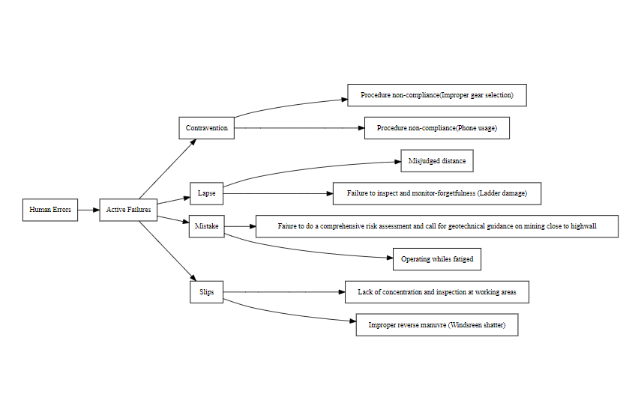
RESULTS AND DISCUSSIONS CONT’D
Hierarchy of Human Errors

Slide 21
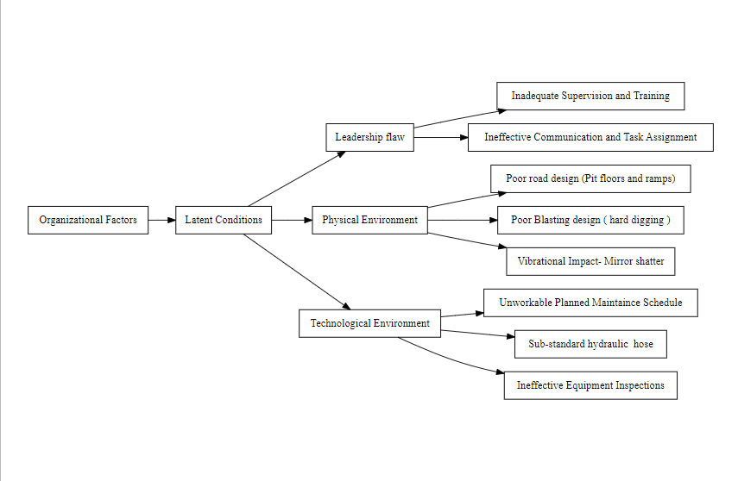
RESULTS AND DISCUSSIONS CONT’D
Hierarchy of Organization Factors

Slide 22
RESULTS AND DISCUSSIONS CONT’D
Classification of Human Errors and Organizational Factors
ACTIVE FAILURES | LATENT CONDITIONS
Slips=7 | Leadership flaw=4
Lapse=3 | Physical Environment=11
Mistake=7 | Technological Environment (Fire)=11
Contravention=6 | (Electrical short circuit=2)
Total=23 | (Mechanical hose burst=9)
 | Total=26

Slide 23
RESULTS AND DISCUSSIONS CONT’D
To determine whether the observed difference is statistically significant, a hypothesis test was conducted;
A non-parametric test (Chi-square goodness-of-fit test) was used to determine whether the frequency distribution of failure types differed significantly from expected values, thereby identifying which failure type had a potentially greater impact.

Slide 24
RESULTS AND DISCUSSIONS CONT’D
Hypothesis Test for Active Failures
Let H₀: be the null hypothesis and H₁: be the alternative hypothesis.
H₀: There is no difference in the distribution of Active Failures; all types (Slips, Lapse, Mistake, and Contravention) occur in equal proportions.
H₁: There is a difference in the distribution of Active Failures; at least one type occurs at a different proportion than the others.

Slide 25
RESULTS AND DISCUSSIONS CONT’D
Based on the chi-square test, a p-value of 0.5999 was obtained at a 95% confidence level.
Since the p-value is greater than the significance level of 0.05, we fail to reject the null hypothesis at the 5% level of significance.
We conclude that there is no statistically significant difference between the types of active failures based on the data under study and hence the variations and frequencies could be due to random chance.

Slide 26
RESULTS AND DISCUSSIONS CONT’D
Hypothesis Test for Latent Conditions
Let H₀: be the null hypothesis and H₁: be the alternative hypothesis.
H₀: There is no difference in the distribution of latent conditions; all types (Leadership flaws, Physical and Technological Environment) occur in equal proportions.
H₁: There is a difference in the distribution of latent conditions; at least one type occurs at a different proportion than the others.

Slide 27
RESULTS AND DISCUSSIONS CONT’D
Based on the chi-square test, a p-value of 0.1519 was obtained at a 95% confidence level.
Since the p-value is greater than the significance level of 0.05, we fail to reject the null hypothesis at the 5% level of significance.
We conclude that there is no statistically significant difference between the types of latent conditions based on the data under study and hence the variations and frequencies could be due to random chance.

Slide 28
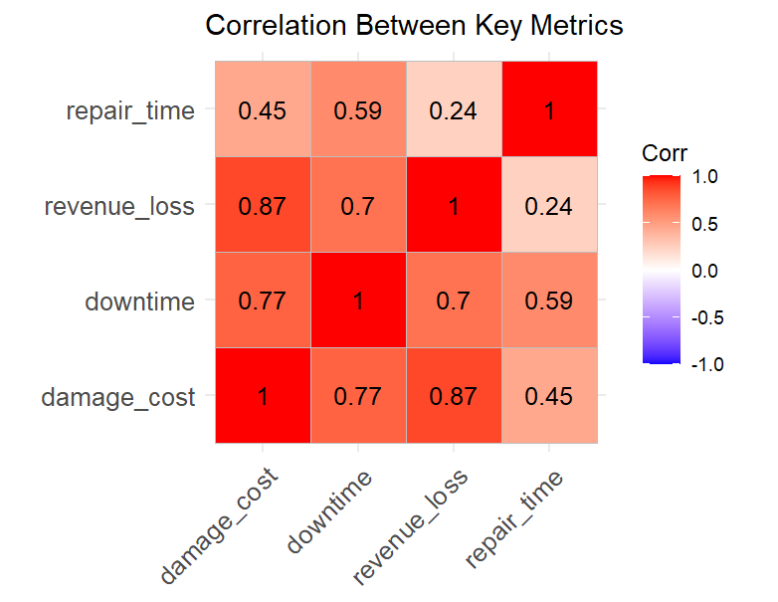
RESULTS AND DISCUSSIONS CONT’D

Slide 29
CONCLUSIONS
The study revealed that human factors significantly contribute to equipment damages in the operations of the Ghanaian mining contractor with fire being the predorminant incident type.
These damages have a direct negative impact on equipment availability, productivity, and overall production performance.
Statistical analysis confirmed a significant relationship between human-induced errors and equipment downtimes, reinforcing the need for targeted human factor interventions.

Slide 30
CONCLUSIONS
Enhancing operator training, supervision, safety culture, and human-machine interface designs can help reduce these errors.
Managing human error is essential not just for improving equipment reliability, but also for boosting operational efficiency and ensuring workplace safety.

Slide 31
RECOMMENDATIONS
It is recommended;
Further study can be done with an increased number of dataset

Slide 32
REFERENCES
Bevilacqua, M., and Ciarapica, F. E., (2018), “Human factor risk management in the process industry: A case study”, Reliability Engineering and System Safety, Vol. 16, No. 9, pp. 149–159
Dhillon, B. (2014). “Human Error in Maintenance: An Investigative Study for the Factories of the Future”, IOP Conf. Ser. Mater. Sci. Eng, Vol. 65, No.1, pp. 20-31.
Dekker, S.W., (2006), “The Field Guide to Understanding Human Error”, pp. 62-67.
Gyekye SA (2003) Causal attributions of Ghanaian industrial workers for accident occurrence: Miners and non-miners perspective. J Safety Res 34:533–538

Slide 33
REFERENCES CONT’D
Reason, J. (1990), “Human Error” Cambridge University Press, New York Cambridge, pp. 56-60.
Reason, J. (2000), “Human Errors, models and management, education and Debate”, pp.768770
Simpson, G. and Horberry, T., (2018), “Understanding human error in mine safety”, CRC Press, pp. 175
Stemn, E., Benyarku, C. A., & Buabeng, A. (2022). Human factor issues associated with mobile mining equipment-related injuries in the Ghanaian Surface Gold Mines. Journal of Mining Safety, 32(4), 320-330

Slide 34
THANK YOU

